Slide 1
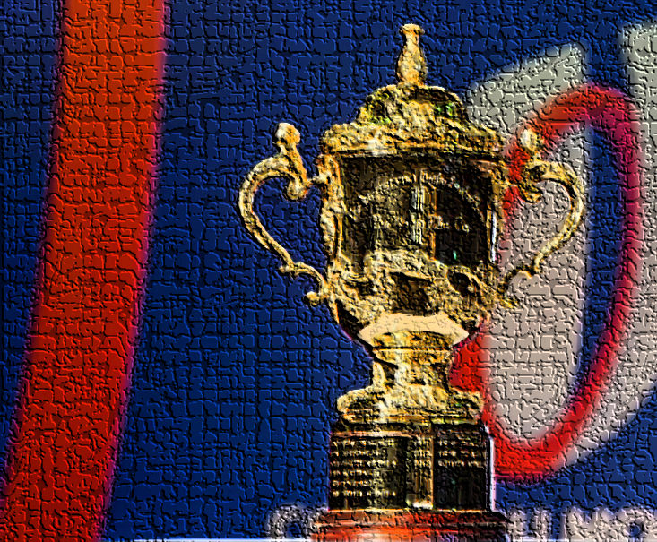
SOUTH AFRICA
THREE TIMES RUGBY WORLD CUP WINNERS!

Slide 2
DID YOU KNOW?
INTERESTING FACTS:
GAMES WON:
South Africa have played at 7 of the 9 Rugby World Cup tournaments
The Springboks are tied with the New Zealand All Blacks for tournament wins at the Rugby World Cup - both teams having won 3 times
They are the only rugby team to have won every World Cup final they have played in
South Africa won against the following countries in the final:
1995 New Zealand
2007 England
2019 England

